Slide 1


SumACE Industrial Supplies Sdn Bhd (1456865-M)
SumACE Southern Supplies Sdn Bhd (1459771-X)
KL Office:
No. 55-2, Jalan Mahkota Residence 1,
Mahkota Residence, Bandar Mahkota Cheras,
43200 Cheras, Selangor.
JB Office:
No. 116-02, Jalan Sierra Perdana 4/1,
Taman Sierra Perdana, 81750 Masai, Johor.
Paka Office & Warehouse:
Lot 10040 (PT 11608), Taman Industri Paka,
23100 Paka, Dungun, Terengganu.
Tel: +603-9011 6813
Office H/P: +6012-569 3193
Email: sales@sumace.com.my
Website: www.sumace.com.my

Slide 2
Vision
Our Vision is to be the service partner of choice for all of our potential customers, and become renowned as a forward-thinking, progressive organization, operating in line with the best interests of our clients and employees.
Incorporated in 28 March 2022
Business Sectors
Our Mission is to be the most capable and reliable distributor of the products that we carry and be the first choice for our customers.
Mission
  Oil and Gas
  Palm Oil Industry
  Petrochemical
  Engineering fabricators
  Marine Shipbuilding
  Others related industries

Slide 3
SumACE Industrial Supplies Sdn Bhd Organisation Chart
Sales Director
AMIR FAIZAL
Executive Director
NUR UZMA
General Manager
MOHD IRWAN
Sales Engineer
MOHD YUSUF
Senior Indoor Sales Executive
NICOLE
Account & Admin Manager
ANGIE
Operation Executive
NURDILLAH
Sales Executive
JAMILIA
Sales Coordinator
HIDAYU
Account & Admin Executive
YANIE
Warehouse Executive
AZRI ISKANDAR
Sales Coordinator
EYKA
Warehouse Storekeeper
NIK ZUHAIRI
Total No of Staffs: 13

Slide 4
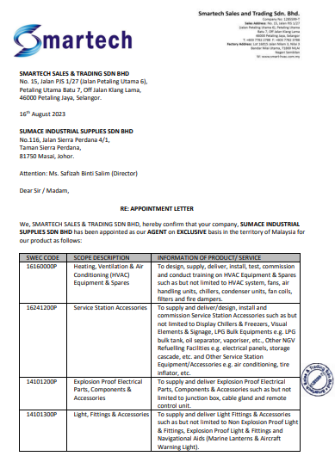
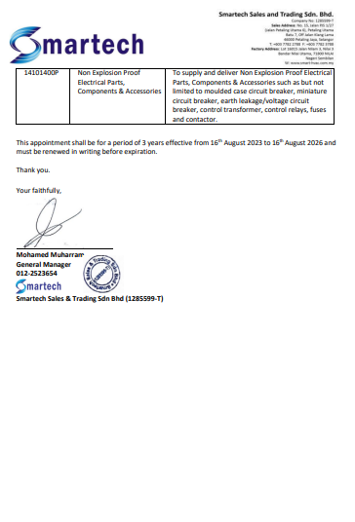
Agency / Distributorship From Our Principal

Slide 5
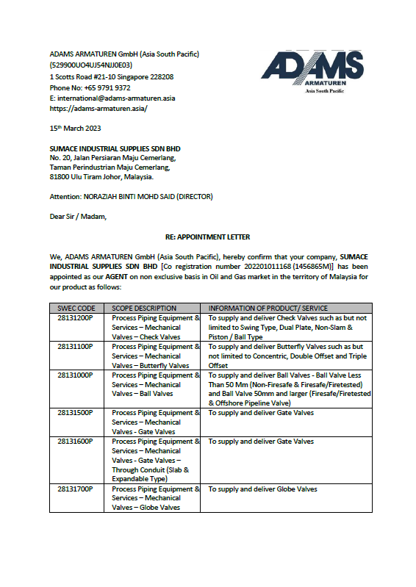
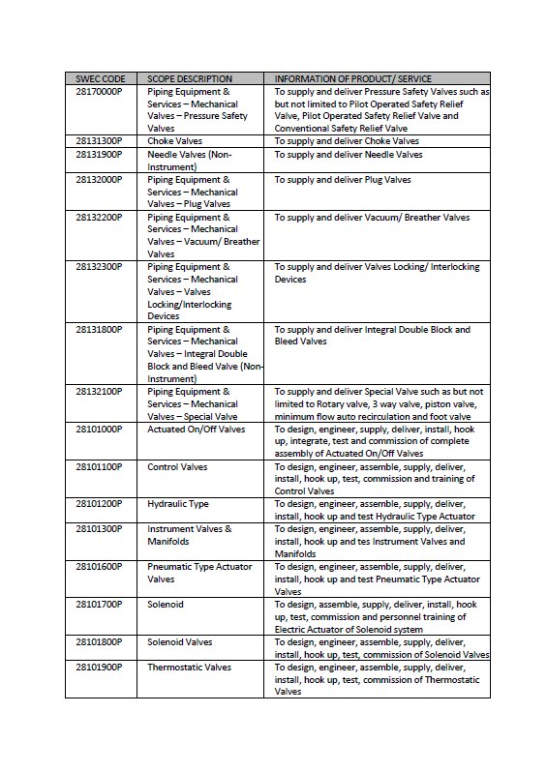
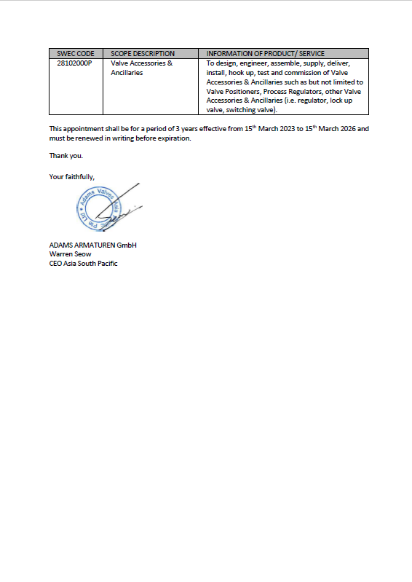

Slide 6
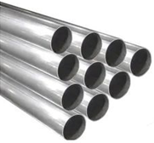

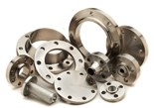
Product Summary
  Pipes
  # Type:
  Seamless / ERW / LSAW / Welded
  # Schedule:
  20 to 160 / STD to XXS
  # Material:
  Carbon Steel / Low Temp Carbon Steel
  Duplex / Super Duplex
  X52 / X65, Alloy Steel & Copper Nickel
  # Brand:
  NipponSumitomo, Tubos, V & M, Tenaris, & ArcelorMittal
  Fittings & Flanges
  # Fittings:
  Elbow (LR/SR), Tee, Reducer (Eccentric/Concentric), Cap, Stud End & ETC
  # Flanges:
  Socket Weld, Weld Neck, Blind, Slip On, Lap Joint & ETC
  # Schedule:
  20 to 160 / STD to XXS
  # Brand:
  Benkan, Wihelm Geldbach, Metalfer, Dong Jin, & GPS

Slide 7
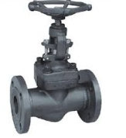
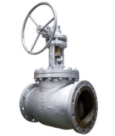
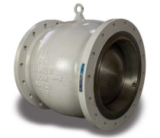
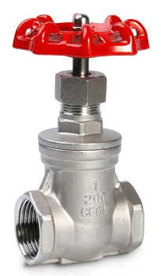
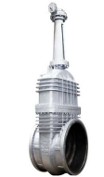
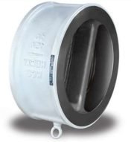
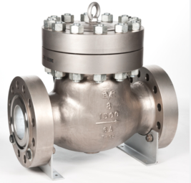
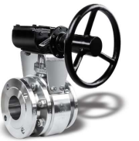
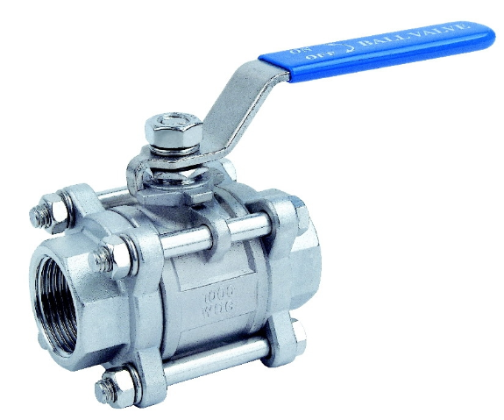
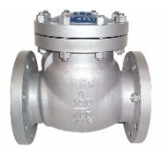
  Valves
  # Type:
  Globe, Gate, & Ball Valve
  # Body Material:
  Carbon Steel, Stainless Steel, Alloy Steel, & Duplex Steel
  # Design Ball Valve:
  Cast / Forged Floating & Trunnion Mounted
  # Rating:
  ANSI 150lb – 2500lb
  # Type:
  Wafer Check Valve
  # Design:
  Dual Plate & Single Plate
  # Body Material:
  Carbon Steel & Stainless Steel
  # Rating:
  ANSI 150lb – 2500lb
  # Type:
  Swing Check & Axial Flow Check Valve
  # Body Material:
  Carbon Steel, Stainless Steel, & Alloy Steel
  # Rating:
  ANSI 150lb – 2500lb

Slide 8
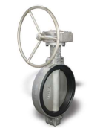
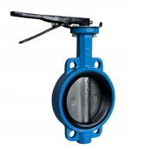
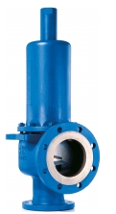
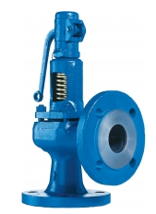
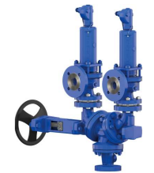
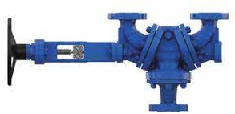
  # Type:
  Butterfly Valve
  # Body Material:
  Carbon Steel, Stainless Steel, Alloy Steel,
  & Duplex Steel
  # Rating:
  ANSI 150lb – 600lb
  # Type:
  Safety Relief Valve
  # Load Type:
  Spring Loaded
  # Body Material:
  Carbon Steel, Stainless Steel, Monel, Hastelloy,
  & Duplex Steel
  # Type:
  Change-Over Valve
  # Body Material:
  WCB / WCC, LCB, CF8M
  # Rating:
  ANSI 150lb – 300lb

Slide 9
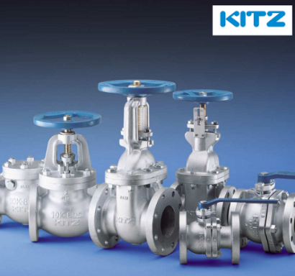


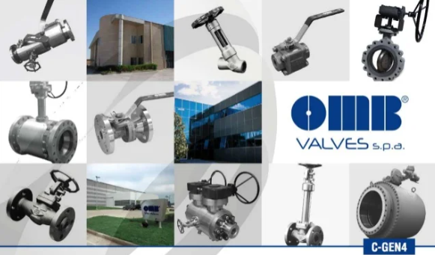
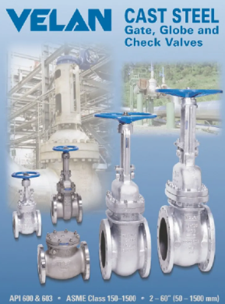
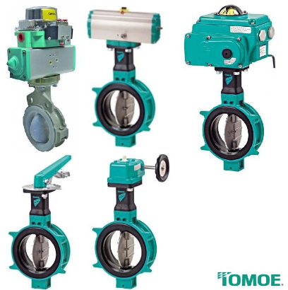


  # Brand:
  Kitz, Bonny Forge, KVC, FLV, OMB, Goodwin, Powell, Velan, Tomoe, Leser, Neway, Wagi, & VMX

Slide 10
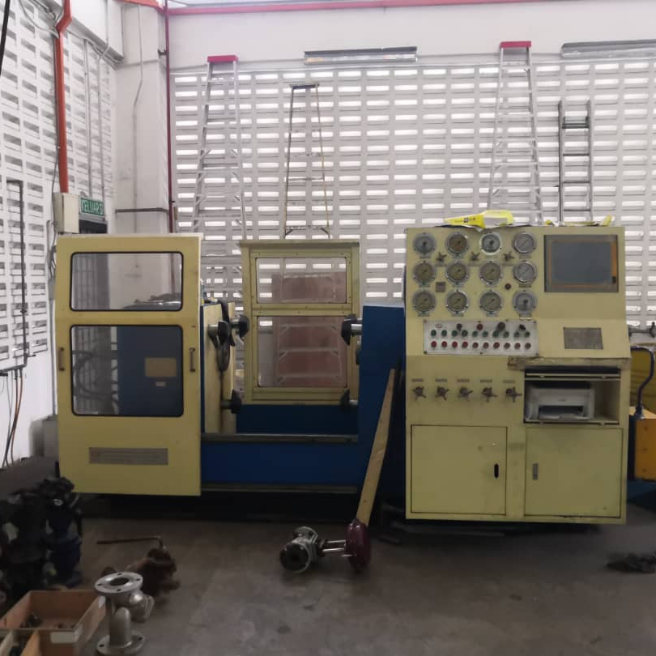
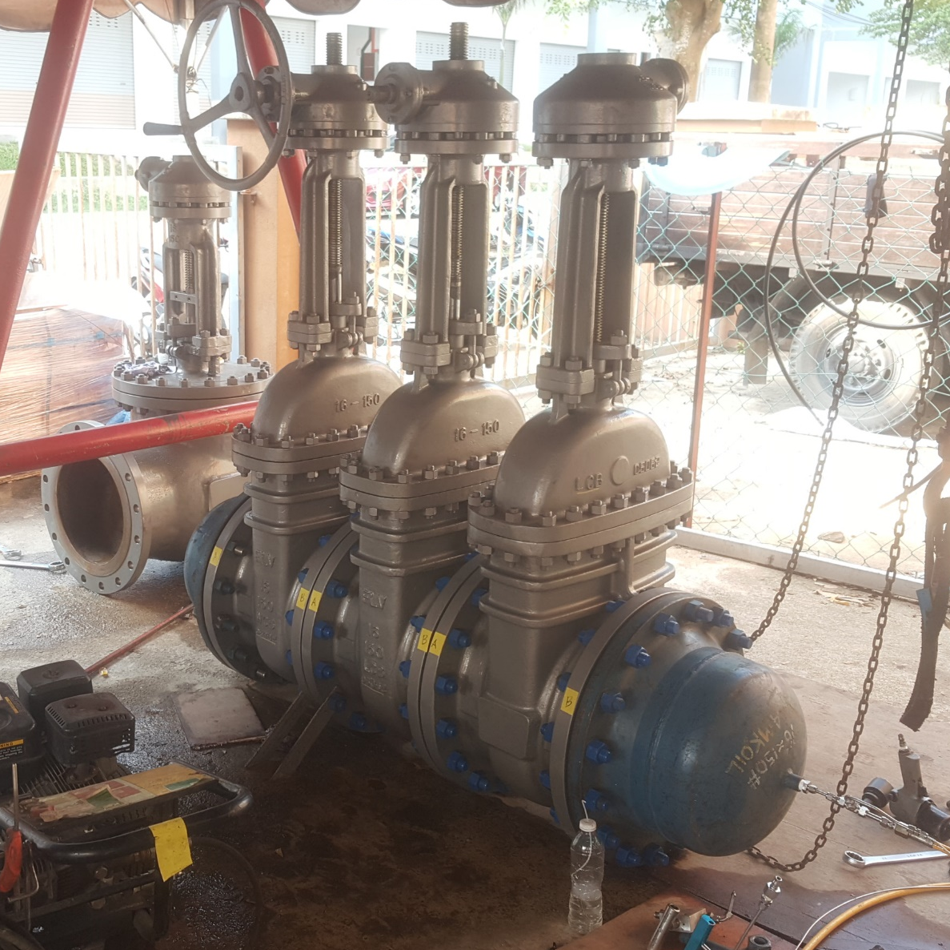
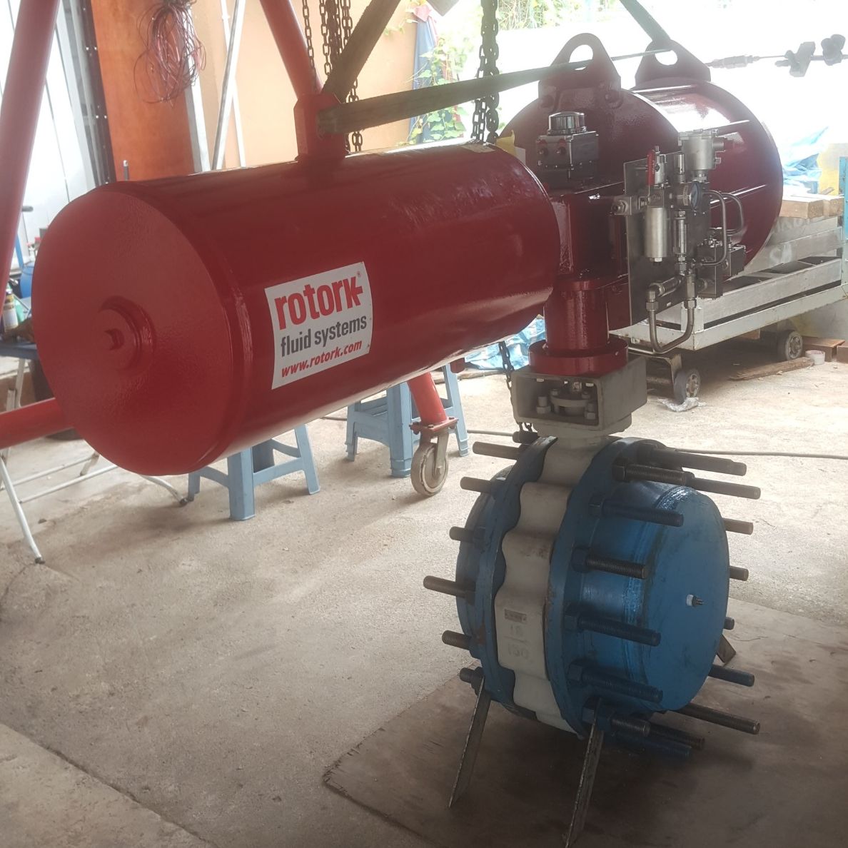
  # We have the experience in delivery of complex valve package along with support services that will enable safe, reliable and cost-effective solution. We are able to provide after-sales services for our client including, but not limited to SAT, FET, & minor repair
  Valve Full Servicing
  Hydrotest
  SAT & FAT

Slide 11
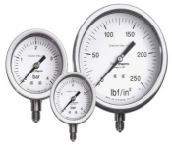
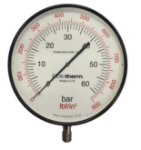
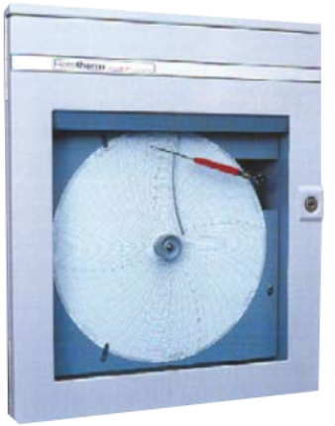
  Mild Steel Pressure Gauge
  # Case Diameter:
  2-1/2”, 4”, 6”
  # Body Material:
  Stainless Steel & Mild Steel
  # Application:
  Pressure / Vacuum / Compound
  Rototherm Mild Steel Case Boiler Gauge
  # Case Diameter:
  2-1/2”, 4”, 6”
  # Body Material:
  Stainless Steel & Mild Steel
  # Application:
  Pressure / Vacuum / Compound
  Rototherm Mild Steel Case Boiler Gauge
  # Chat Size:
  9” 9”
  # Mounting:
  Wall / Panel
  # Chat Drive:
  Mechanical / Electrical / Battery
# Element Material:
3/8” / 1/2” Male BSPT
# Process Connection:
Phosphor Bronze / Stainless Steel

Slide 12


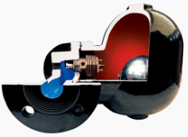
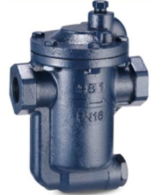
  CALGAZ Calibration Can 6D
  # Contents:
  103 Liters
  # Service Pressure:
  69 Bar (1000 psig)
  CALGAZ Calibration Can 6DM
  # Contents:
  58 Liters
  # Service Pressure:
  69 Bar (1000 psig)
  Ayvaz Steam Trap
  # Size:
  1/2” – 1”
  # Design:
  Thermostatic Steam Trap & Thermodynamic Steam Trap
  # Body Material:
  A105, Forged Carbon Steel, & A105 Stainless Steel
  # Working Pressure:
  Up to 32 Bar & Up to 40 Bar
  # End Connection:
  Screwed End BSPT
# Type:
Non-Refillable
# Dimension:
352mm x 83mm
# Type:
Non-Refillable
# Dimension:
83mm x 204mm

Slide 13
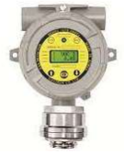
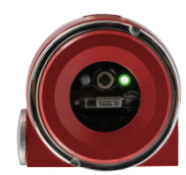

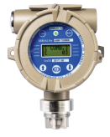

  Gas Detector
  # Type:
  Gas Detector, Flame Detector, Hydrocarbon Gas Detector, Portable Multi Gas Detector, Combustible Gas Detector, Smoke Detector, & ETC
  # Brand:
  Gastron, Apollo, Siemens, G-Finder Multi, Rosemount, Hochiki, Notifier, Vesda, & ETC
  Wagi Y Type Strainer
  # Size:
  1/2” – 2”
  # Body Material:
  Cast Iron / F316
  # Rating:
  PN16 / 600#
  # Perforated Mesh:
  60
# End Connection:
Screwed End BSPT

Slide 14
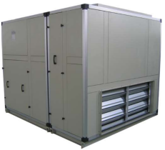
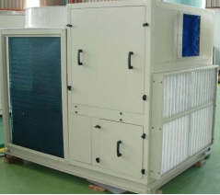
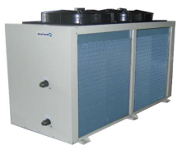
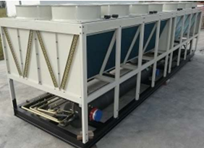
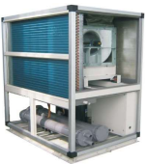
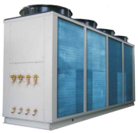
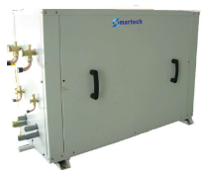
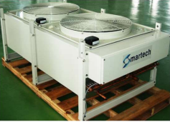
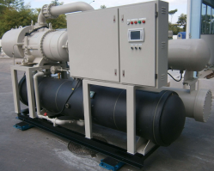
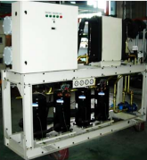
  Air Conditioning Chillers & Products
  # Type:
  Air Handling Units, Split and Packaged Type, Air Conditioners, VRF Air Conditioners, Associated Products, Absorption Chillers, Centrifugal Chillers, Calmac Ice Banks Rotary Screw Chillers, & Brine Chillers
  # Brand:
  Smartech, Hitachi, LG, & ETC
F

Slide 15
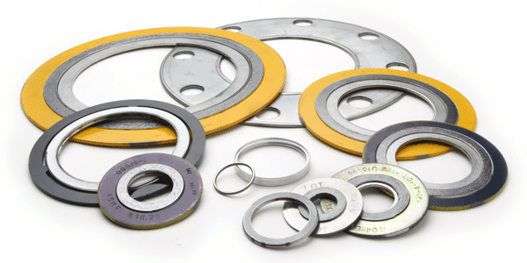
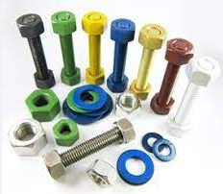

  Gaskets
  # Type:
  Rubber Sheet, Vegetable Fiber Sheet, Graphite, Synthetic, Aramid Fiber,
  Carbon Fiber, Nickel Foil/ Graphite, Handhole/ Manhole/ Type R, IOR, IR,
  OR, Double Jacketed, & ETC
  # Brand:
  Flexitallic, Moorside (US), Klinger, Chesterton (Europe),
  Tombo (Japan), & Teadit (Austira)
  Studbolts & Nuts
  # Type:
  Hexagon, Structural Hex Bolts & Nuts, U-Bolts, Eye Bolts, Long Nuts,
  Cap Screw, & ETC
  # Material Grade:
  ASTM 193, A194, A320, Stainless Steel, Duplex, & Special Grade
  Structural Steel
  # Type:
  Plate, Round Bar, Angel Bar, C-Channel, Beam, Column, & ETC.
  # Material:
  Carbon Steel, Mild Steel, & Stainless Steel.
  # Brand:
  Jikang (MY), NipponSumitomo, Dongkuk, Siam Yamato, Krakatu Posco, & ETC

Slide 16




  Electrical Product
  # Type:
  Cable, Cable Glands, Cable Trunking, Lighting Fixtures, Power Supply,
  Battery, Fuse, Module, & ETC
  Explosion Proof Electrical Parts, Components, & Accessories
  # Brand:
  Draka, Southern, Mastertec, Hi-E, CMP, Hawke, Capri, Cabtex, Ortac,
  Osram, MSA, & Siemens
  Hardware & Consumables
  # Type:
  Paint Marker, Spray Paint, Elec Tape, Measuring Tape, Masking Tape, Cutter, Screwdriver,
  Padlocks, Thinner, Lubricent, Snoop Liquid Leak Detector, Handle Brush, Chain, Canvas,
  Grinder, Regulator, Ladder, Hammer, Scraper, Safety Cone, & ETC
  # Brand:
  Nippon, 3M, Total, Tiger, M-Safe, Swagelok
  PPE
  # Type:
  Ear Plug, Ear Muff, Eyewear, Gloves, Coverall, Safety Helmet, Safety Vast, Safety Belt,
  Safety Shoe, Multi Gus, Respirator, Headlamp, Flashlight, & ETC
  # Brand:
  3M, MaxiFlex, MaxiCut, MaxiDry, MaxiChem, Tanizawa, Milwaukee, Safety Guard,
  Nomex, Colex, Uvex, MSA, Houston, Pelican, & M-Safe

Slide 17




  Bearing & Housing
  # Product Types:
  Bearing, Housing, Bearing Units, Withdrawal Sleeves, Adaptor Sleeves,
  Hydraulic Nut, & Slewing Rings
  # Brand:
  SKF, Asahi, Timken, NIS, Aurora, Morse, Rexnord, & ETC
  Belts & Pulleys
  # Product Types:
  V-Belts/ Kraftband, Rubber and Polyurethane Timing Belt, Special Pulley/ Taper Lock Bush,
  Custom Polyurethane Timing Belt – backings/ coatings/ attachments, Ribbed Belt,
  Automotive Ribbed Belt, Fan Belt, & Timing Belt and Kit
  # Brand:
  SKF, Optibelt, Martin, Fenner Drives, Eagle, & Fleco
  Chains and Sprockets, & Couplings
  # Product Types:
  Drive Chain, Heavy Duty Drive Chain, Conveyor Chain, Construction Chain,
  Top Chain, Sprockets, & Chain Accessories
  Gear Coupling, Grid Coupling, Elastomeric Coupling, Disc Coupling, Fluid Coupling,
  Composite Coupling, & Long Term Grease
  # Brand:
  SFK, NIS, Rexnord, Diamond, Drives, Tollok, Intralok, B-Loc, & ETC
  SFK, Lovejoy, NIS, Falk, Kop-Flex, Martin, Rexnord, & Thomas

Slide 18

Petronas License (Smart GEP, SUS Portal, & Dropee)

Slide 19

Top 20 Petronas’s Order List

Slide 20

FGV License

Slide 21






Warehouse & Office
Our Stocks & Warehouse
Our office

Slide 22





















Our Clients

Slide 23

Thank you.

